Slide 1


Powering Decentralized Identity
paul.kohlhaas@consensys.net @paulkhls

Slide 2
Identity for Blockchain vs Blockchain for Identity
Identity within Blockchain
Identities with private keys are required to interact with blockchains
Blockchain for Identity
Self-sovereign identity can be realized with blockchain and smart contracts
Challenges today:
Key Management
Persistent Identity
Authenticating the User (link to ‘real-world')
Challenges today:
Identity Ownership
Data Ownership
Reputation Fragmentation
Password Management

Slide 3







Identities Today are Siloed and Insecure
Users’ identities and linked data are stored in siloed, centralized servers across organizations
… leading to the following issues
For organizations:
Limited information sharing prevent collaboration, interoperability & efficiency
Cyberattacks: insecure centralised data storage increases vulnerability to hacking
Vital records office
Car registration
authority
For users:
Physical identity documents
Repetitive account creation, Inconvenience of remembering passwords
Personal information (often outdated) stored in various services
Identity theft vulnerability
Healthcare system
Tax authority

Slide 4
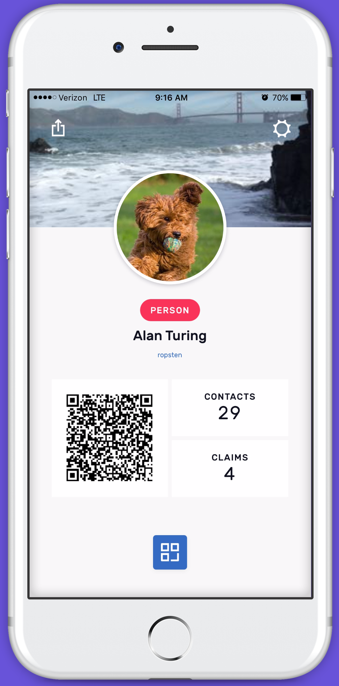
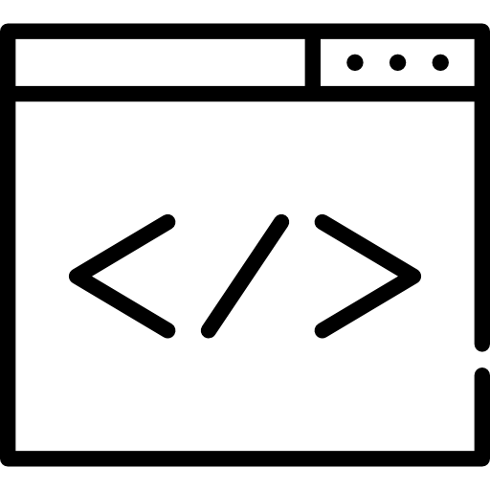
Solution: Self-Sovereign Identity
Secure, cost-effective, and interoperable blockchain identity
For the first time in history, public blockchains enable a truly self-sovereign identity platform:
Identity and personal data is stored with the user
Claims and attestations can be issued and verified between users and trusted parties
Users selectively permission access to data
Data only needs to be verified a single time
Decentralized Identity System:
leads to a very flexible, universal, robust identity that empowers its users
Govts, Apps, Businesses
User’s
mobile
Decentralized Smart contracts
1. Mobile generates keys, maps to smart contract
2. Blockchain: role as trust provider, decentralized PKI
3. Issue credentials to users

Slide 5
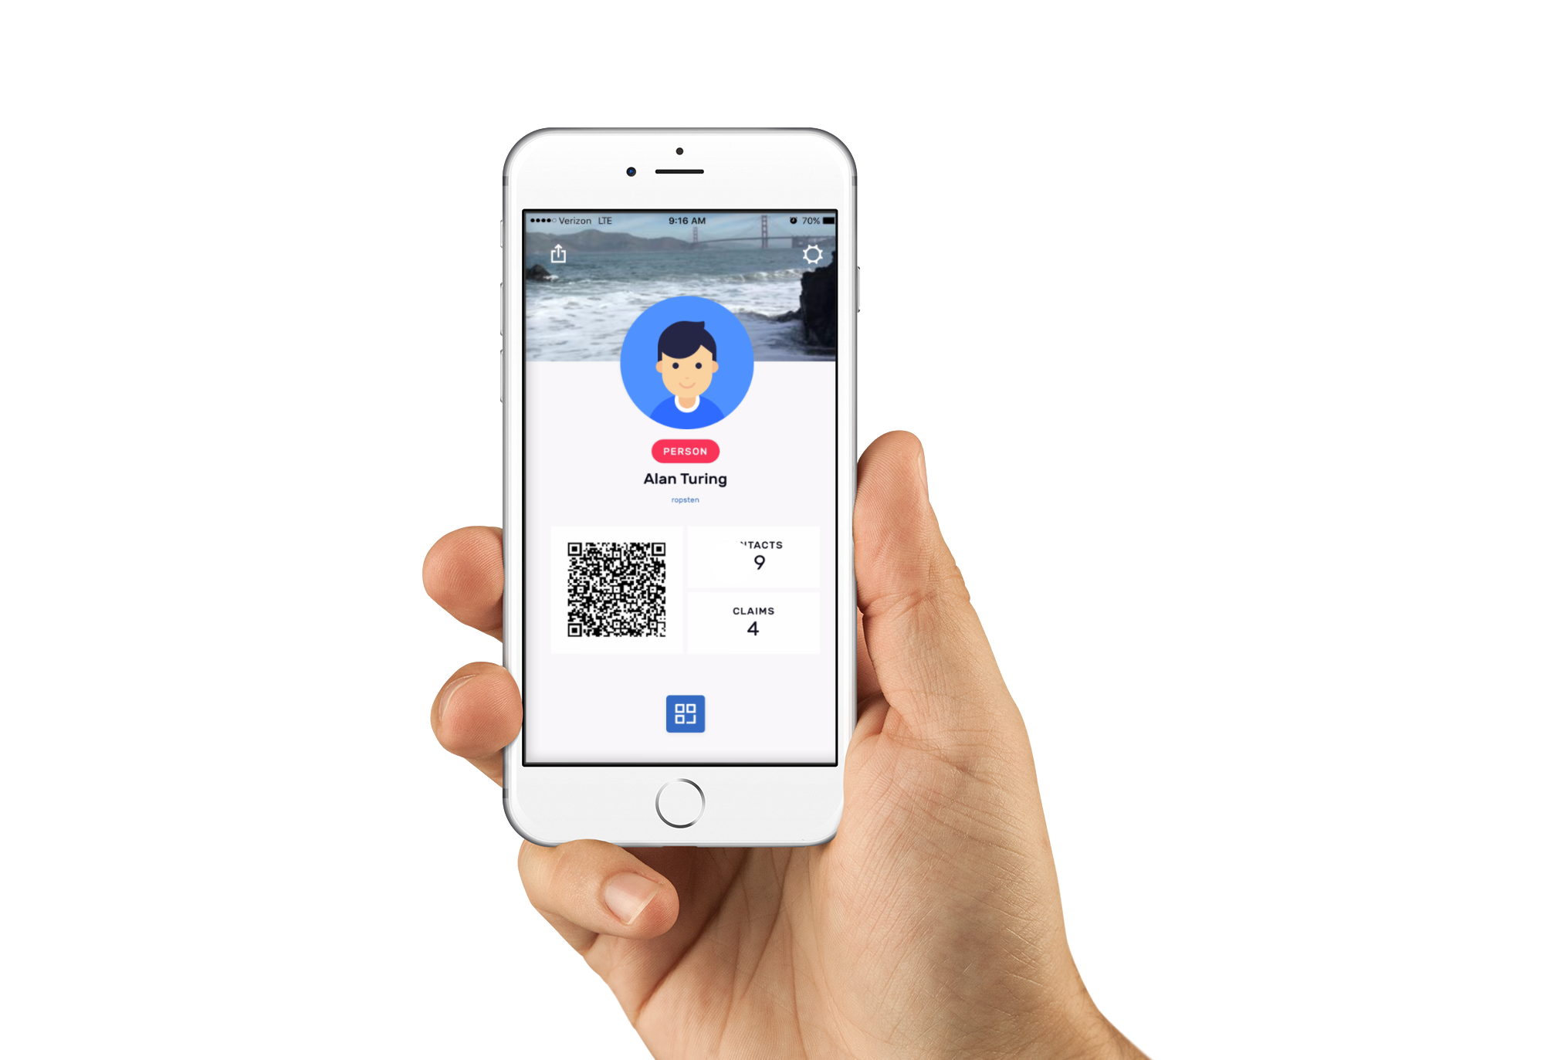








Introducing uPort
uPort is a mobile self-sovereign identity solution and secure sign-on tool built on Ethereum.
uPort features
Identity rooted in Ethereum blockchain
User friendly blockchain Transaction Card
Passwordless, Single Sign-On
Push Communication Protocol
Simplified user centric key management
Upcoming: Mobile SDK
Legally binding signatures (depends on jurisdiction)
Upcoming: Gateway for private chains

Slide 6








What is a uPort Identity?
A permanent blockchain identity
Self-sovereign identifier
Collection of data credentials acquired through everyday interactions
Controlled by the user with a private key
A collection of data
Verified data or claims that belong to the individual (certificates, visa, citizenship)
Standard schema for attribute data that can represent legal facts, receipts, etc.
Represent a person’s reputation
Timestamp
Recipient ID
Claim Data
Issuer ID
Issuer Signature

Slide 7
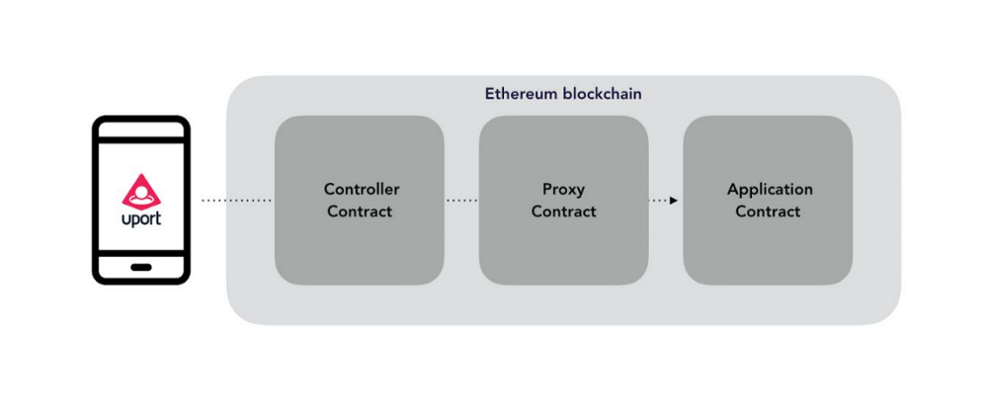
Core Concept & Smart Contracts
Secure key-storage
Persistent Identitier (building an identity & reputation)
Recovery mechanisms - e.g. social recovery

Slide 8
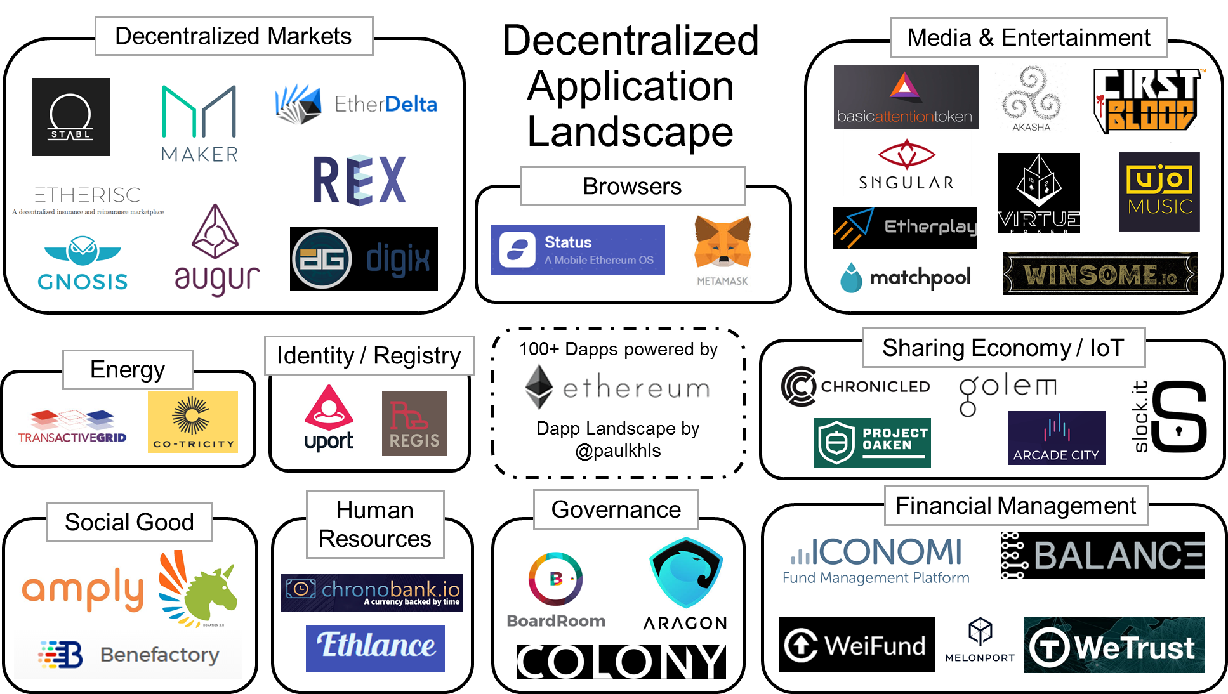
Who uses uPort?
End-users
Developers
Dapps
Exchanges
Enterprises
Governments

Slide 9






Sample Business Use Cases
P2P Marketplaces
Reputation Network: Interoperable user reputation data between services for more secure, trustworthy interactions – perfect for the on-demand economy.
Consumer Finance
Shared Data and KYC: Improve customer insights and KYC processes for greater operational efficiency.
eCommerce and Retail
Boost Conversion: Significantly reduce customer dropoff, cart abandonment, and fraud with verified, secure single sign on and formless checkout.
Social Media
User Lifecycle Management: Improve onboarding and user lifecycle management without having to store personally identifiable information.
Digital Media
Portable Preferences: Users bring preferences with them for increased content personalization, smart recommendations, and simplified onboarding and UX.
Regulated Finance
Secure Credentials and KYC: Reduce fraud, improve KYC process, and benefit from shared credential marketplace with other trusted providers.

Slide 10
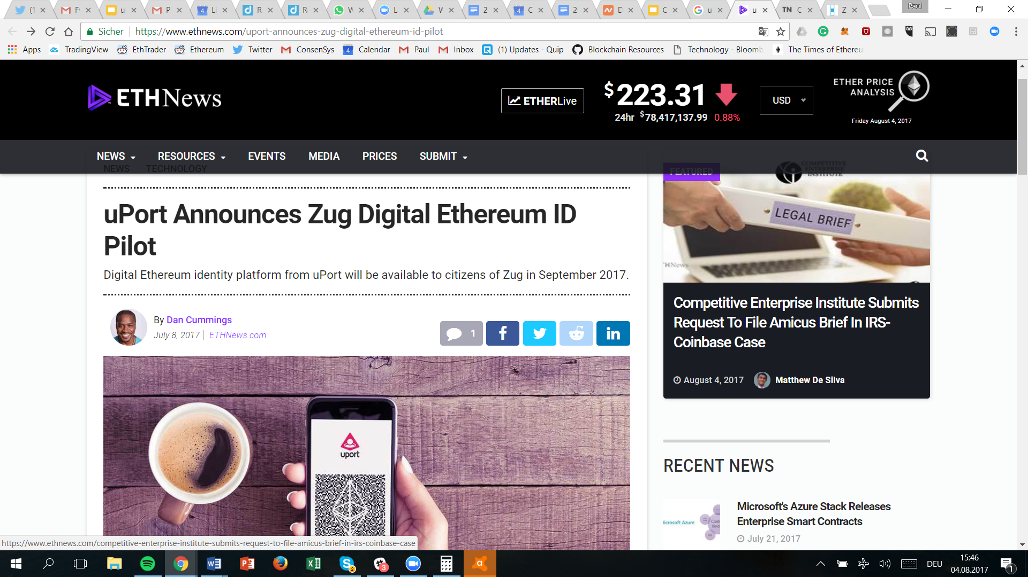
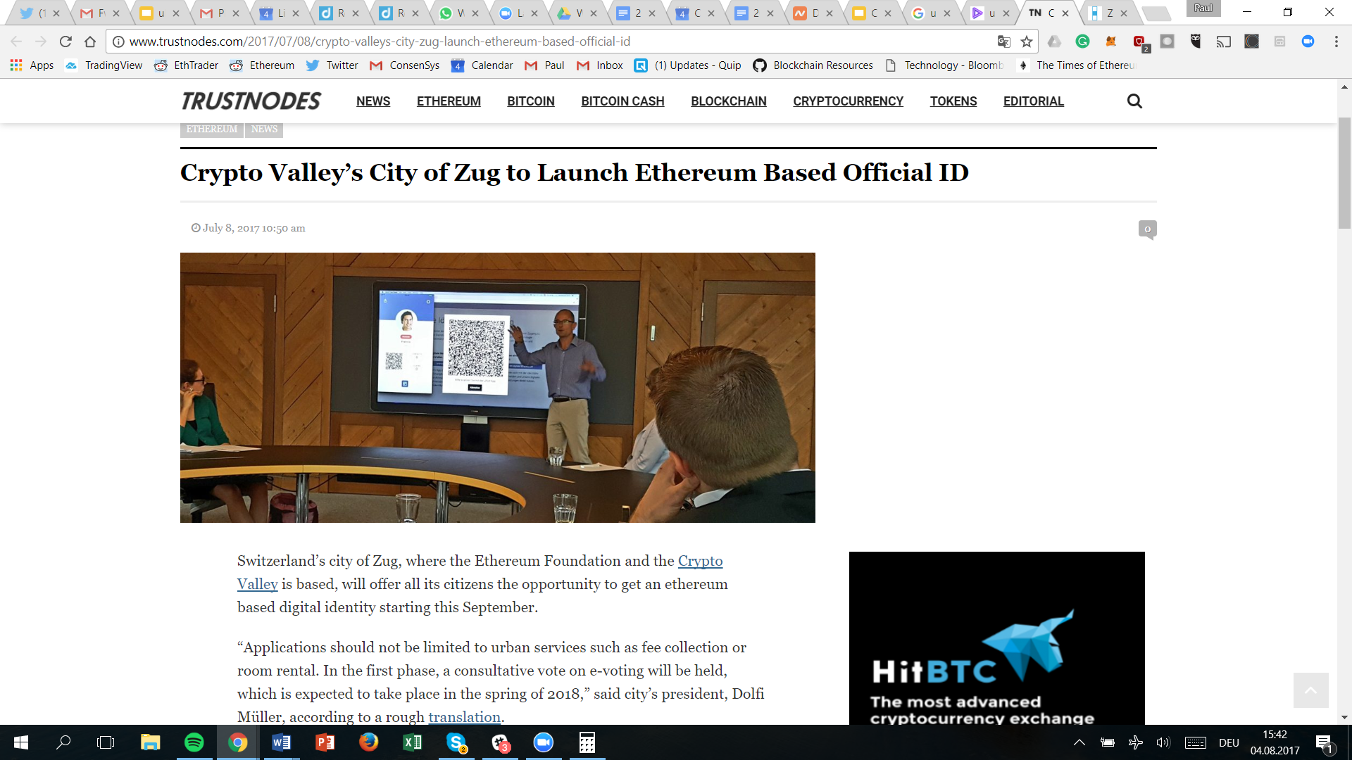
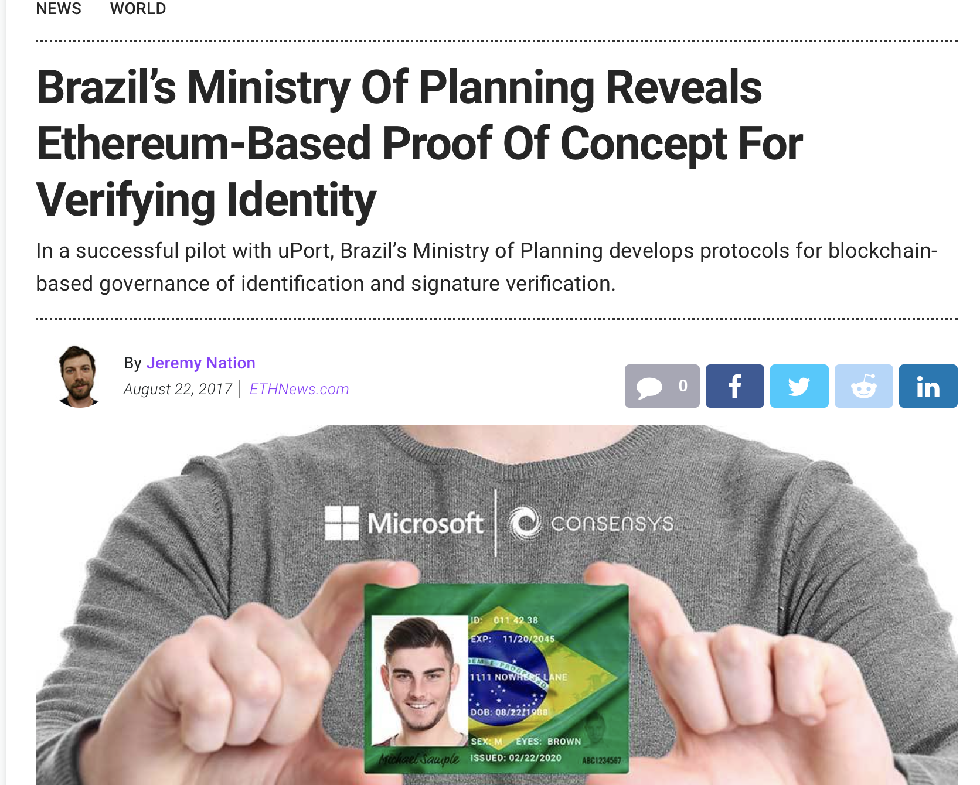
Case Study: Government Integrations
Switzerland and Brazil: Pilots completed and developing production ready government systems
City of Zug, Switzerland
The solution allows citizens to self-register using uPort and officially verify their decentralized ID by visiting a local Certification Authority (CA)
Citizens can then use uPort to log into the citizen web portal to securely access government services such as e-voting or tax payments
Ministry of Planning, Brazil
Citizens can upload document for signature and notarization from other parties
Combination of public and private chain implementation

Slide 11
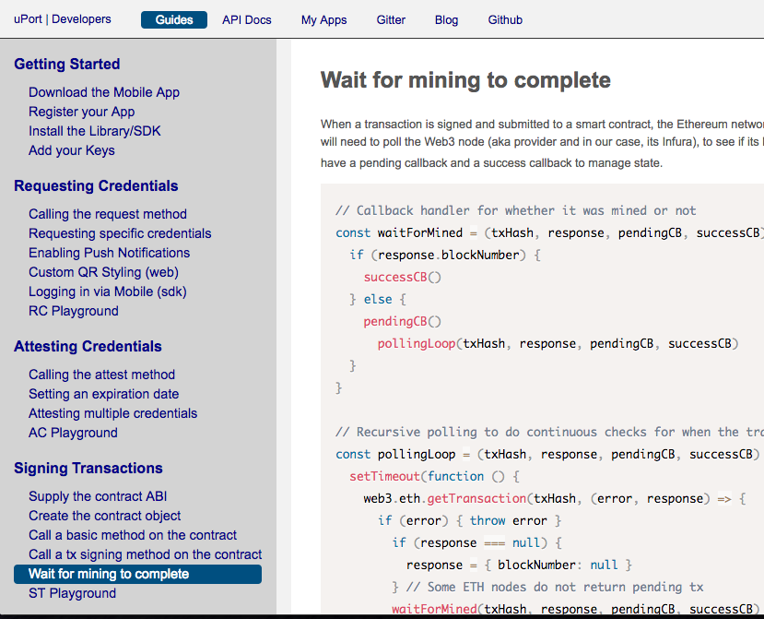
uPort Documentation & Getting Started
All in one documentation site
Learning guides & live embedded examples
Library documentation
App Manager (register your app)
Developer chat (Gitter)
Engineering blog
developer.uport.space
(** The site is under active development)
Android https://play.google.com/apps/testing/com.uportMobile
iOS Apple AppStore

